Slide 1
RLL PROJECT
CHILTERNOAK
Group - 4

Slide 2


Group Members:
Emp Id:
ALA SUBRAMANIYAN 2584427
MADANAPALLI PRASAD 2583334
MIRUTHULA S 2584282
MOHD SAIF 2583318
PAVULURI VISHAL 2584098
POLUMATI SASIDHAR 2583567
VENKATESH ARNIPALLI 2583834

Slide 3
Introduction
Objective
Java
Selenium
Cucumber
TestNG
POM Framework
Extent Reports
Log4j
Jenkins
Jira
Conclusion
Agenda

Slide 4
Chilternoak
Chilternoak is a UK based e-commerce furniture website.
It is a one stop solution for your interior needs.
Furnitures are crafted with care from premium materials and hand-picked
by specialists.Customer services team are on hand to help you find the final
piece of the puzzle to your home.
The website has various features like door delivery to make customer
shopping hassle free

Slide 5
Introduction
This project revolves around exploring and evaluating the diverse functionalities of the Chilternoak Furniture website.
Manual test cases are created. Tools and frameworks such as Selenium, TestNG, and Cucumber are used.
Extent reports and logs are used for Reporting. To address failed test cases, IRetryAnalyser is used to take screenshots for analysis.
Data-driven concept is used for reading data.
Jira is employed for managing the test lifecycle in this project.

Slide 6
Objective
To automate the test scenario and generate the reports for e-Commerce website https://www.chilternoakfurniture.co.uk/.
Using automation script all the pages of the e-commerce website are tested systematically, and transactions are validated.
Testing the website can provide a seamless, reliable and user-friendly experience.

Slide 7
Java
Java is a popular, versatile, and widely-used programming language that is known for its portability, flexibility, and extensive ecosystem of libraries and frameworks.
It's used for developing a wide range of software applications, including web applications, mobile apps, enterprise software, and more.
Using automation script all the pages of the e-commerce website are tested systematically, and transactions are validated.

Slide 8
Java in Automation Testing
Java is widely used in automation testing due to its platform independence, robustness, extensive ecosystem, integration capabilities, and performance.
1Automation testing, facilitated by Java and other technologies, offers numerous benefits in terms of efficiency, reliability, coverage, and cost-effectiveness for software development teams

Slide 9
SELENIUM
Selenium is a powerful open-source framework commonly used for automating web applications.
It is used by software developers and testers to write scripts in various programming languages (such as Java, Python, C#, Ruby, and others) to automate interactions with web browsers.
Selenium WebDriver is a web framework that permits you to execute cross-browser tests. This tool is used for automating web-based application testing to verify that it performs expectedly.

Slide 10
Uses of selenium web application
Automated Testing:
Selenium is widely used for automated testing of web applications. It allows testers to write scripts to simulate user interactions, perform actions, and verify expected outcomes.
Accessibility Testing:
Selenium can be used in combination with other tools to perform accessibility testing, ensuring that web applications are accessible to users with disabilities.
Web Scraping:
Selenium can be used for web scraping, extracting data from websites for various purposes. Developers can use it to automate the process of navigating through web pages, filling out forms, and extracting desired information.
Performance Testing:
Selenium can be used to automate performance testing scenarios by simulating a large number of users interacting with a web application simultaneously. This helps in identifying performance bottlenecks and optimizing web application performance.

Slide 11
CUCUMBER
Cucumber is a widely used open-source tool for Behavior-Driven Development (BDD) in software testing.
Cucumber is a BDD framework that allows tests to be written in natural language, making them more readable and understandable.
Cucumber uses a syntax called “Gherkin”. Gherkin uses plain text with keywords like Given, When, Then, And, & But to describe test scenarios.
It encourages collaboration between technical and non-technical stakeholders in the software development process.
Cucumber is compatible with popular software platforms like Selenium, Ruby, and others.

Slide 12
USE CASES:
Feature Files: Feature files contain scenarios, steps, and examples for testing different aspects of the application and test scenarios are written in plain text files with a .feature extension.
Scenario Outline: This helps in creating data-driven tests with different input combinations.
Background: Cucumber feature files can include a Background section, defining preconditions that apply to all scenarios in the file.
Step Definitions: Step definitions map Gherkin language steps to actual code that performs the actions and verifications.
Parameterization: The variables are passed as arguments to the corresponding step definition methods.
Integration with Page Objects Model: Step definitions interact with Page Objects to perform actions on the web elements of the ChilternOak website.

Slide 13
Data Driven:
Data Driven Testing:
Data Driven Testing is a software testing method in which test data is stored in table or spreadsheet format. Data driven testing allows testers to input a single test script that can execute tests for all test data from a table and expect the test output in the same table. It is also called table-driven testing or parameterized testing.
Data Driven Framework:
Data Driven Framework is an automation testing framework in which input values are read from data files and stored into variables in test scripts. It enables testers to build both positive and negative test cases into a single test. Input data in data driven framework can be stored in single or multiple data sources like .xls, .xml, .csv and databases.

Slide 14
Why Data Driven Testing?
Data Driven Testing is important because testers frequently have multiple data sets for a single test and creating individual tests for each data set can be time-consuming.
Data driven testing helps keeping data separate from test scripts and the same test scripts can be executed for different combinations of input test data and test results can be generated efficiently.

Slide 15
Scenarios Functionalities
Sign Up: Create a new account by entering your details. Verify your email to get started.
Login: Log in with your username or email, and password. Stay logged in for convenience.
Search: Find what you need by typing keywords. Refine results with advanced filters.
Subscribe: Get newsletters and updates by subscribing.
Cart: Add products of your needs, adjust quantities, for an easy check out.
Filters: Find products easily with category and price filters. Customize filters for your preferences.
Contact Us: Use the contact form for inquiries or feedback and assistance of Customer support.

Slide 16
SignUp:
Created an Automation Script to test the Functionality of “SIGN UP” for the Chiltern-Oak Furniture Website.
Prepared 4 Test Cases namely – Creating an Account with all valid details, Creating account without Password, Creating account without Name and Creating Account with a Weak password.
Valid Details – Performs user registration with Name, Email and Password to create a New Account.
Without Password – Performs user registration with all required fields except password and the registration fails.
Without Name – Performs user registration without giving First & last name, but the registration is successful.
Weak Password – Performs user registration with all the details but the Password has less than 5 characters. So the registration fails prompting the user about the password strength.

Slide 17
Login:
Created an Automation Script to test the Functionality of “LOGIN” for the Chiltern-Oak Furniture Website.
Prepared 7 Test Cases namely – Signing in with Valid details, Signing in with Empty fields, Signing in with invalid password, Signing in with invalid Username, Signing in only with username, Signing in only with password and Signing in without password.
Valid details – Performs Login with all the correct details and Login is successful
Invalid details – Performs Login with Incorrect Username and Password. So the Login fails.
Empty Fields – Performs Login with blank fields and Login fails.
Invalid Password – Performs Login with Valid username but Invalid Password and the Login fails.
Invalid Username – Performs Login with Valid password but Invalid Username and the Login fails.
Only with Username – Performs Login only with Username without password and Login fails.
Only with Password – Performs Login only with Password without Username and Login fails.

Slide 18
Search:
Created an Automation Script to test the Functionality of “SEARCH” for the Chiltern-Oak Furniture Website.
Prepared 5 Test Cases namely – Searching with Valid term, Searching with Empty field, Searching with an Invalid item, Searching with a Misspelled word and Searching with multiple words.
Valid Term – Performs a Search with a right keyword to get the relevant products.
Empty Field – Performs an Empty Search with a blank field and we don’t get any results.
Invalid Item – Performs a Search with a Product which doesn’t exist in the Website and we don’t get any results.
Misspelled Word – Performs a Search with an Incorrectly spelled Product name and we don’t get any results.
Multiple Word – Performs a Search with a Valid Product name which has multiple words and we get the relevant result.

Slide 19
Filter:
Created an Automation Script to test the Functionality of “FILTER” for the Chiltern-Oak Furniture Website.
Prepared 4 Test Cases namely – Filter by Category, Filter by Price, Filter by Color and Filter by Style
Filter by Category – Performs Filtering by selecting a specific Category and the relevant products are displayed.
Filter by Price – Performs Filtering by dragging the Price limit and the products which fall under the Price range are displayed.
Filter by Color – Performs Filtering by selecting a specific Color and the products of that selected Color are displayed.
Filter by Style – Performs Filtering by selecting a specific Style and the products of that Style are displayed.

Slide 20
AddToCart:
Created an Automation Script to test the Functionality of “CART” for the Chiltern-Oak Furniture Website.
Prepared 4 Test Cases namely – Adding Valid Item and removing, Adding Multiple items, Increasing the Quantity and Adding Invalid items.
Adding & removing – Performs Searching a Valid Product, Adding it to the Cart and then removing it from the Cart. The Cart is Successfully Empty.
Adding Multiple items – Performs Searching for 3 different products and adding all of them into the cart. All products are added Successfully.
Increasing the Quantity – Performs Increasing the no. of items for an already existing product in the cart. And the Quantity of the product in the cart is Successfully increased
Adding Invalid Items – Performs Searching and Adding a Product that isn’t available on the website.

Slide 21
Subscribe:
Created an Automation Script to test the Functionality of “SUBSCRIBE” for the Chiltern-Oak Furniture Website.
Prepared 4 Test Cases namely – Subscribing with Valid Email, Subscribing with Invalid Email, Subscribing with Non -format Email and Subscribing with Blank field.
Valid Email – Performs Subscribing to the Website using a Correct Email address and the Subscription is Successful.
Invalid Email – Performs Subscribing to the Website with Invalid Email address and the Subscription fails prompting the user about the incorrect email.
Non- Format Email – Performs Subscribing to the Website with an improperly typed Email address. So the Subscription fails prompting the user about the format which is missing “@”
Empty Field – Performs Subscribing to the Website without entering Email address in the field. So the Subscription fails prompting the user to fill out the field.
.

Slide 22
Contact Us:
Created an Automation Script to test the Functionality of “CONTACT US” for the Chiltern-Oak Furniture Website.
Prepared 5 Test Cases namely – Filling up the form with Valid Details, without Email, Filling with Empty fields, without name and without Contact Number.
Valid Details – Performs Filling the Contact form with all Valid Details and The Contact request is Successful.
Without Email – Performs Filling the Contact form without Email id and the Request fails prompting the user to enter the required field.
Empty Field – Performs Filling the Contact form without any of the details and the Request fails prompting the user to enter the required fields.
Without Name – Performs Filling the Contact form without the Name but the Request is Successful.
Without Contact Number – Performs Filling the Contact form without Phone number but the Request is Successful.

Slide 23
Introduction To TestNG
TestNG (Test Next Generation) is a testing framework inspired by JUnit and NUnit, designed for simplifying test configuration and parallel execution.
TestNG offers powerful features for testing Java applications and provides a more flexible and easily configurable testing environment.
The design goal of TestNG is to cover a wider range of test categories: unit, functional, end-to-end, integration, etc., with more powerful and easy-to-use functionalities
TestNG makes automated tests more organized, readable, maintainable, effective, and user-friendly. Its high-end annotations make it simple to scale while executing cross-browser testing across multiple devices, browsers, and their versions.

Slide 24
Interactive HTML Reports:One of the key features of Extent Reports is the creation of interactive HTML reports. These reports provide a graphical representation of test results, making it easy to identify passed, failed, or skipped tests
TESTNG LISTNER
In TestNG, a listener is an interface that allows the customization of test execution behaviour.
TestNG listeners are used to perform actions or respond to events that occur during test execution lifecycle
These events can include the start or completion of a test, the success or failure of a test method.
Listener is not a class in TESTNG -> it is an Interface
.

Slide 25
ITestListener :
Purpose: Handles events related to the entire test suite
Usage: Allows you to respond to suite-level such as the start and finish of test suite, test, or configuration method.
IRetryAnalyzer :
An ‘IRetryAnalyzer’ in TestNG is an interface used to implement custom retry logic for failed test cases.
When a test method annotated with ‘@Test’ fails, the ‘IRetryAnalyzer’ is invoked to decide whether the test should be retried or marked as a final failure.
We need to create a class that implements this interface and override the ‘retry’ method to specify the retry behaviour based on our requirements.

Slide 26
Log4j
Log4j is a robust and versatile logging framework for Java applications.
It facilitates the generation of log messages from various parts of your code.
Log4j can be used to log exceptions, errors, and stack traces encountered during test execution. This helps in identifying and debugging issues more effectively.
Integrating Log4j into automation testing framework can greatly enhance the visibility and traceability of test execution, making it easier to analyze test results, identify issues, and debug failures.

Slide 27
EXTENT REPORTS
Extent Reports is a Java-based reporting library that facilitates the creation of comprehensive and interactive HTML reports for test automation.
It is commonly used in conjunction with testing frameworks like Selenium and Cucumber to enhance the presentation and analysis of test results.
EXTENTREPORTS LIBRARY:
Extent Reports is an open-source reporting library useful for test automation. These reports are HTML documents that depict results as pie charts. They also allow the generation of custom logs, snapshots, and other customized details.

Slide 28
Extent Reports are typically used in Java-based test automation frameworks, such as Selenium WebDriver or Appium, to generate interactive and informative HTML reports for test executions.
Test Automation Frameworks : Selenium WebDriver: Extent Reports can be integrated into Selenium WebDriver-based automation frameworks to provide detailed test execution reports.
Integration in Test Code : Extent Reports are integrated into the test code by creating instances of the ExtentReports and ExtentTest classes. Test results and information are then logged during the test execution.
Logging Test Information:Test information such as test status, logs, screenshots, and other details can be logged using ExtentReports. This helps in creating a detailed and easily understandable report.

Slide 29
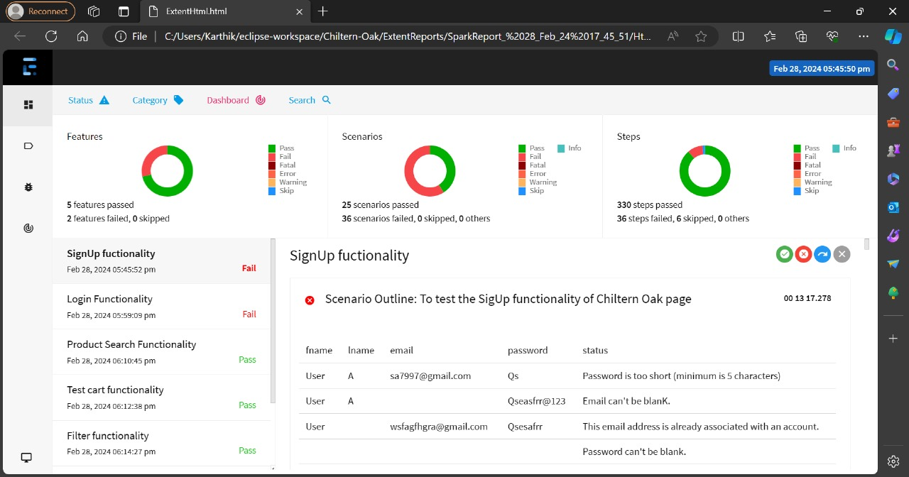
SCREENSHOTS

Slide 30
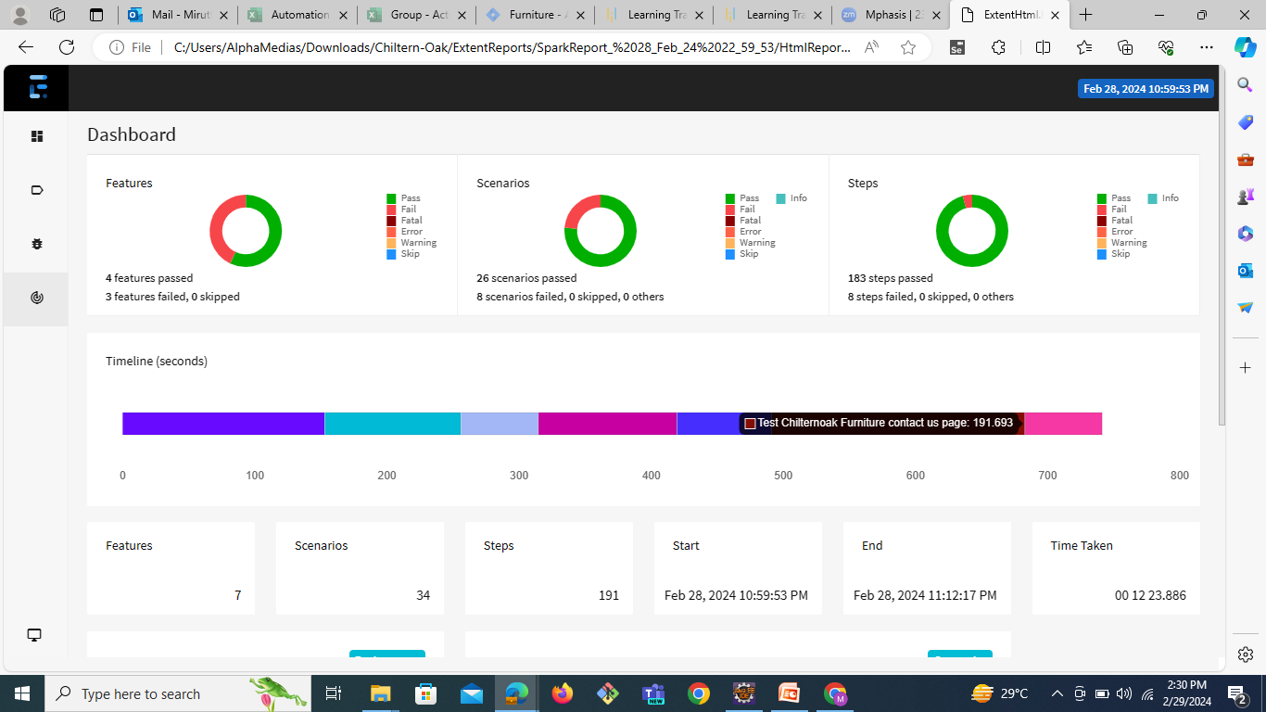
EXTENT REPORTS

Slide 31
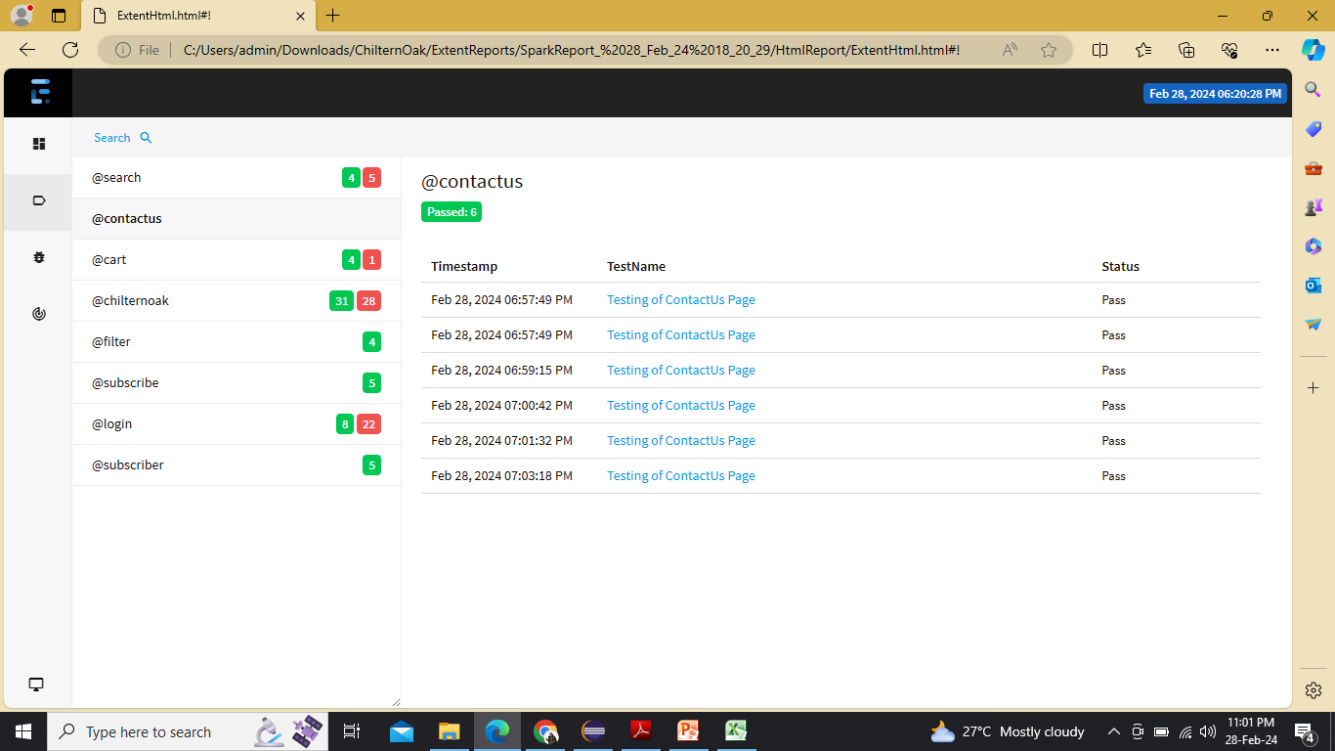
EXTENT REPORTS

Slide 32
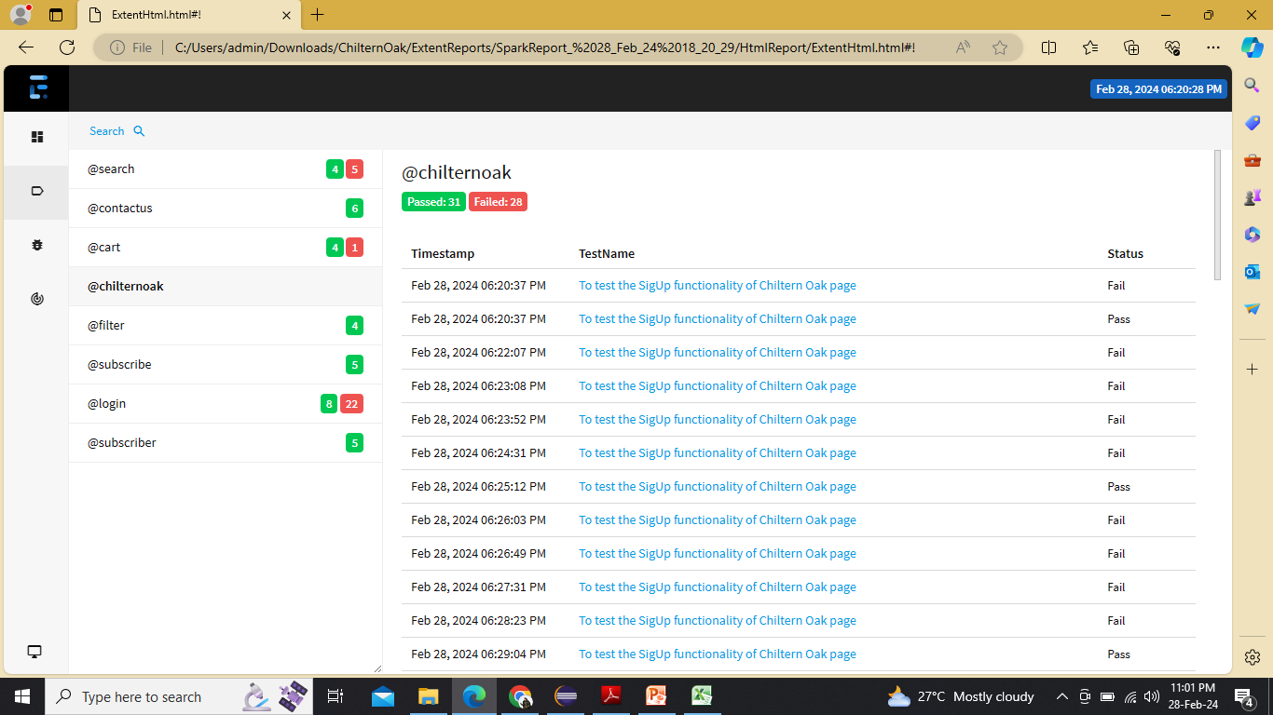
EXTENT REPORTS

Slide 33
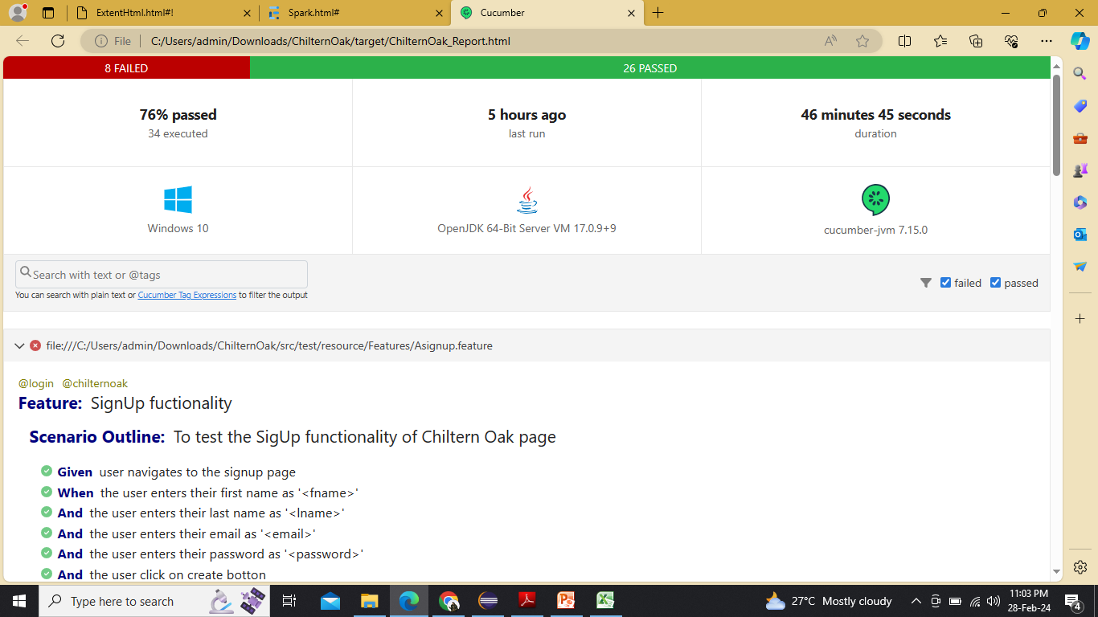
EXTENT REPORTS

Slide 34
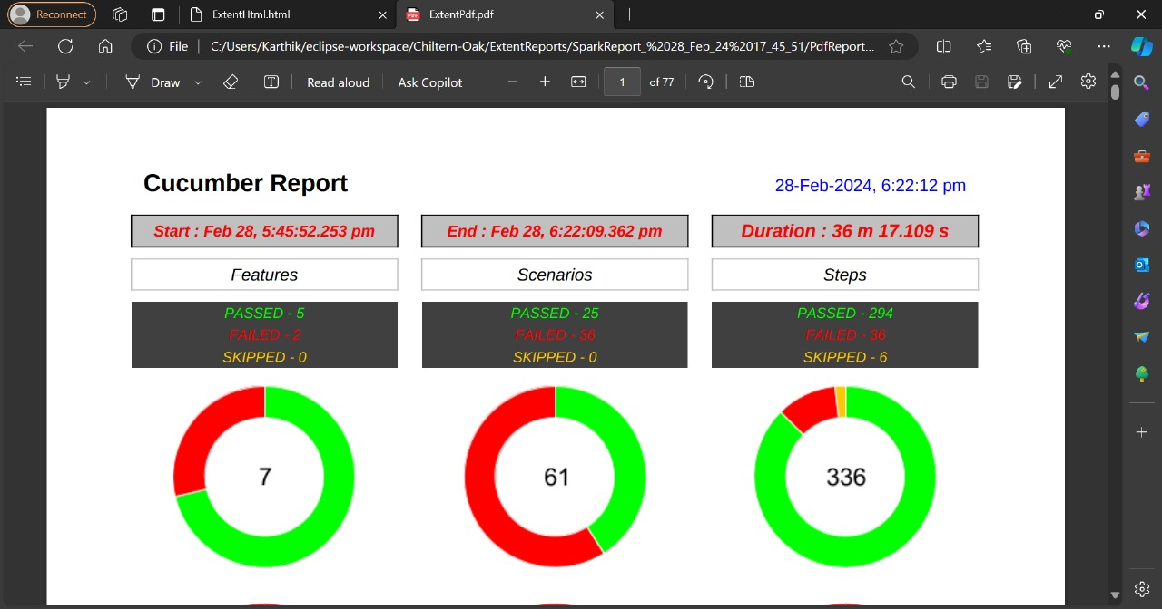
EXTENT REPORTS

Slide 35
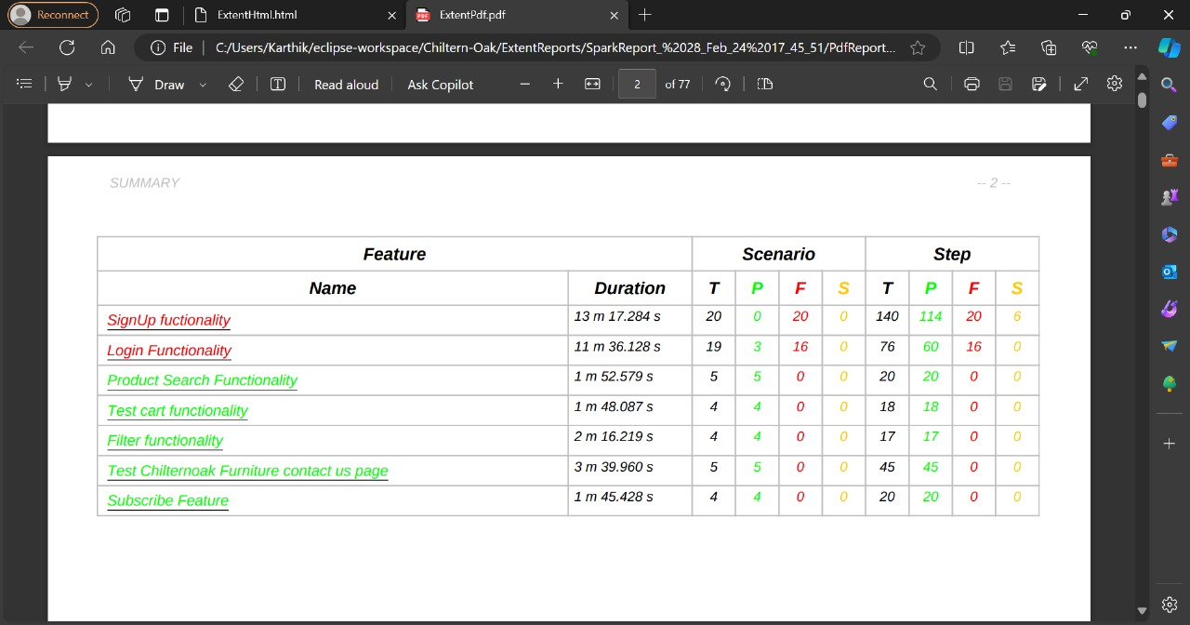
EXTENT REPORTS

Slide 36
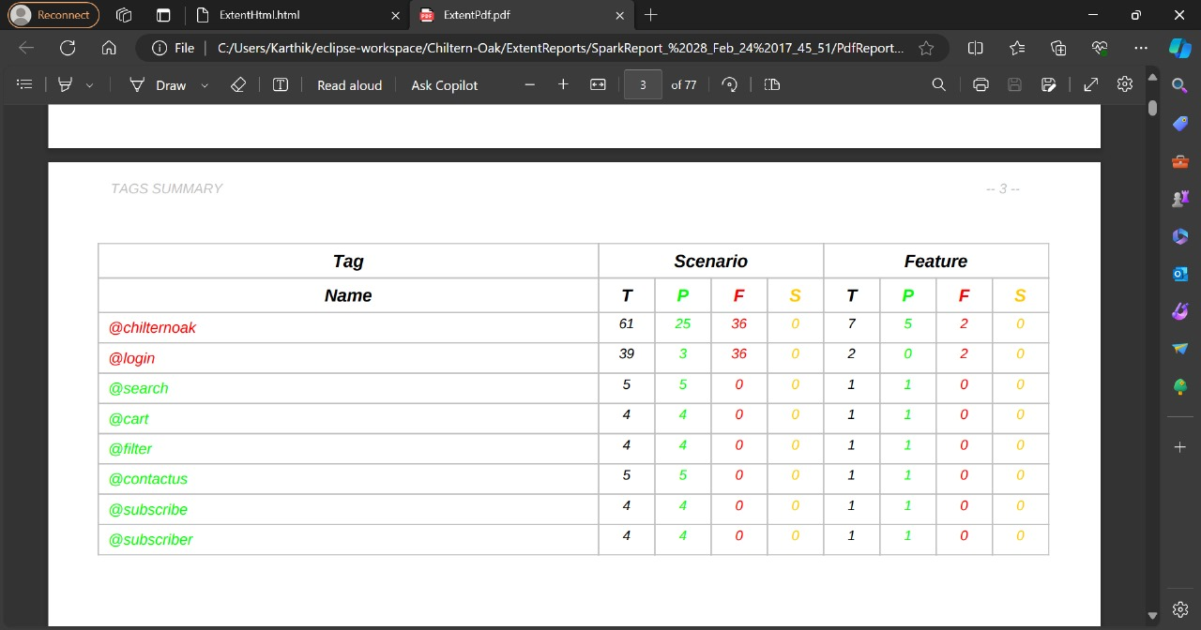
EXTENT REPORTS

Slide 37
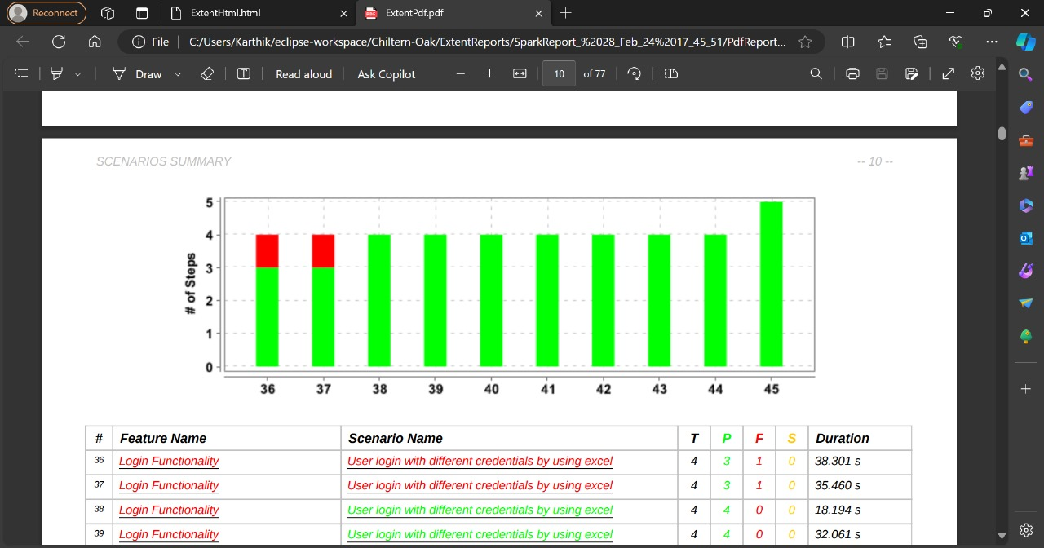
EXTENT REPORTS

Slide 38
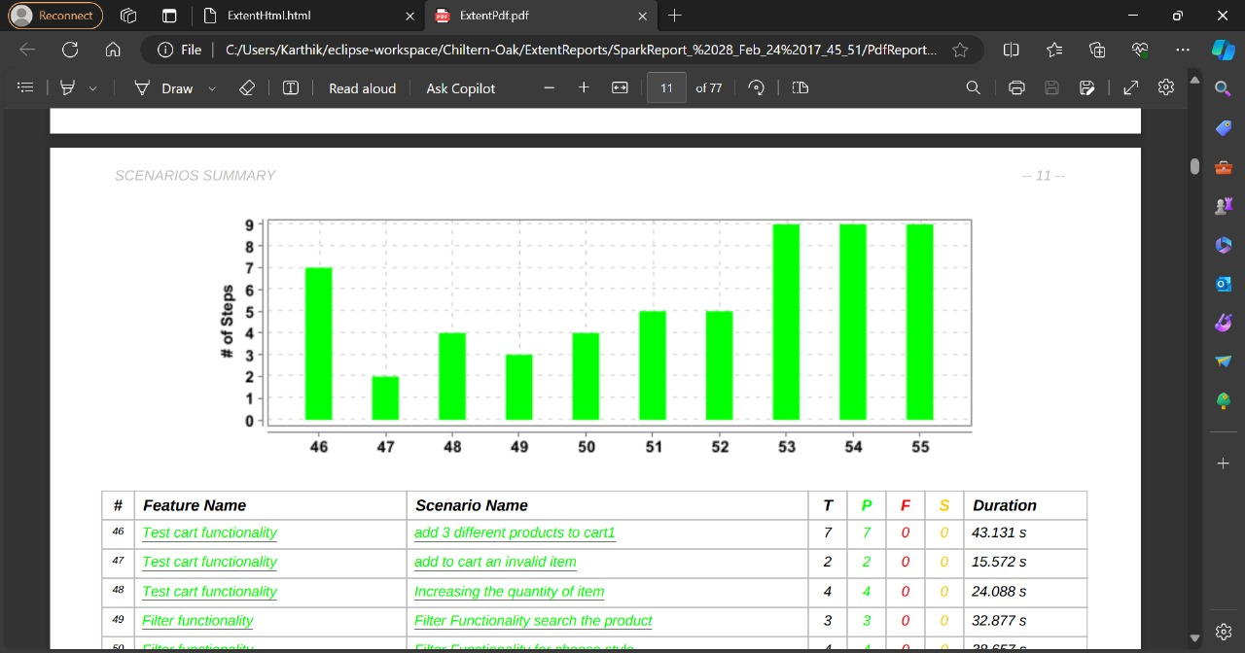
EXTENT REPORTS

Slide 39
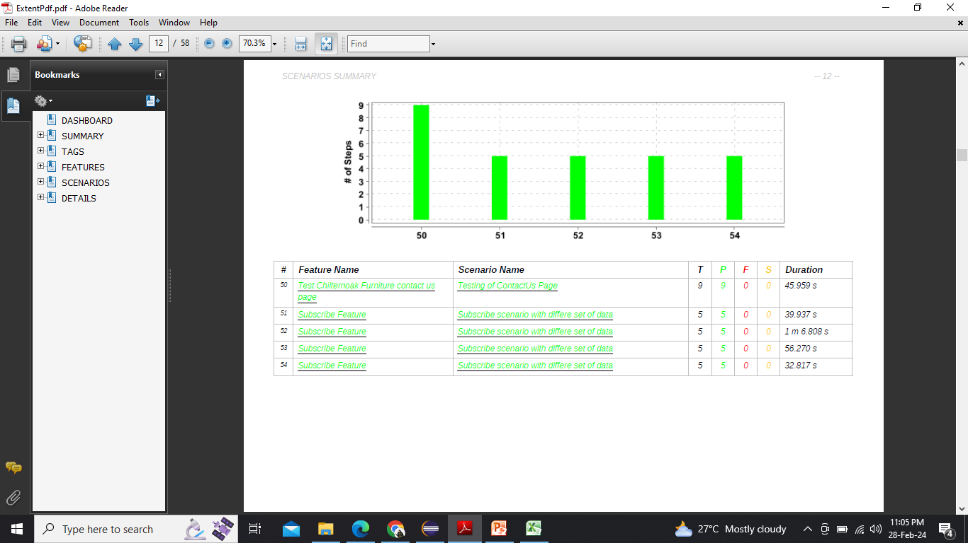
EXTENT REPORTS

Slide 40
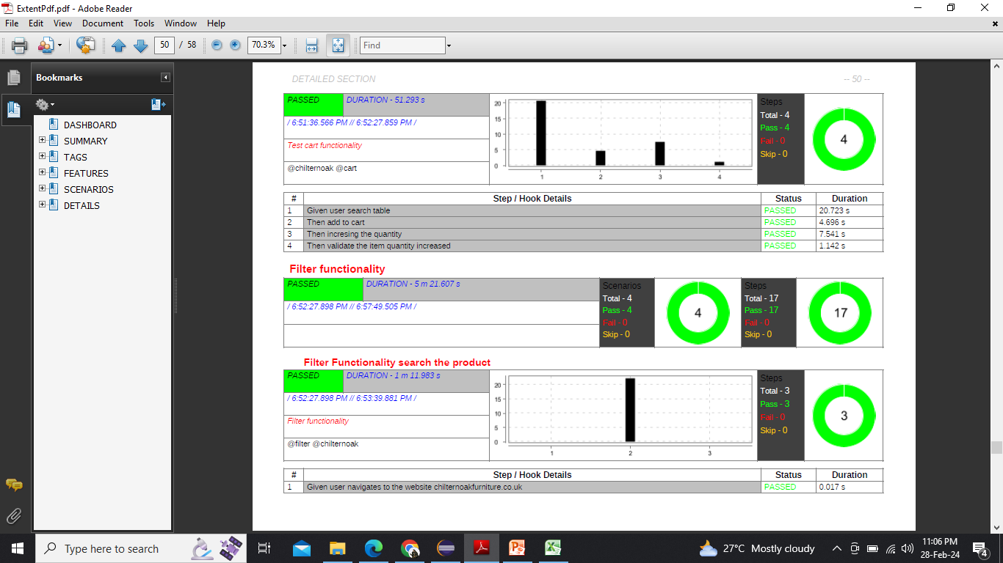
EXTENT REPORTS

Slide 41
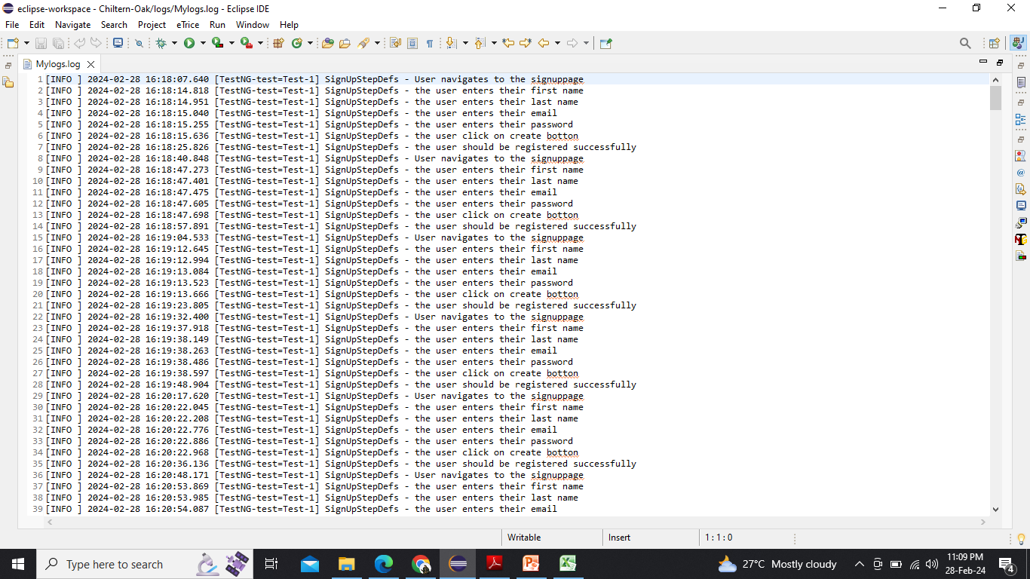
EXTENT REPORTS

Slide 42
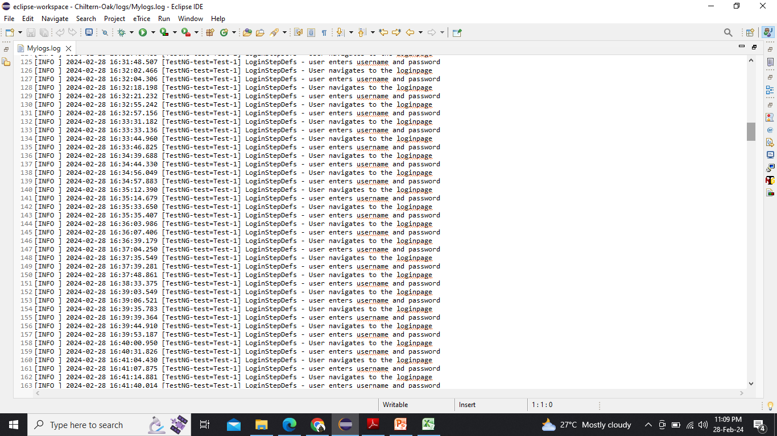
EXTENT REPORTS

Slide 43
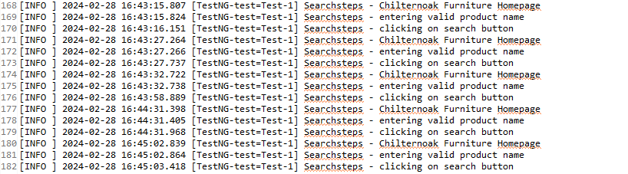
LOGS

Slide 44
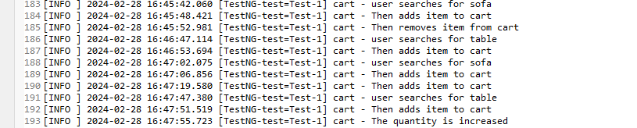
LOGS

Slide 45
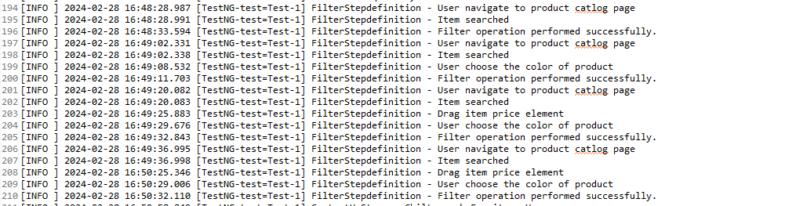
LOGS

Slide 46
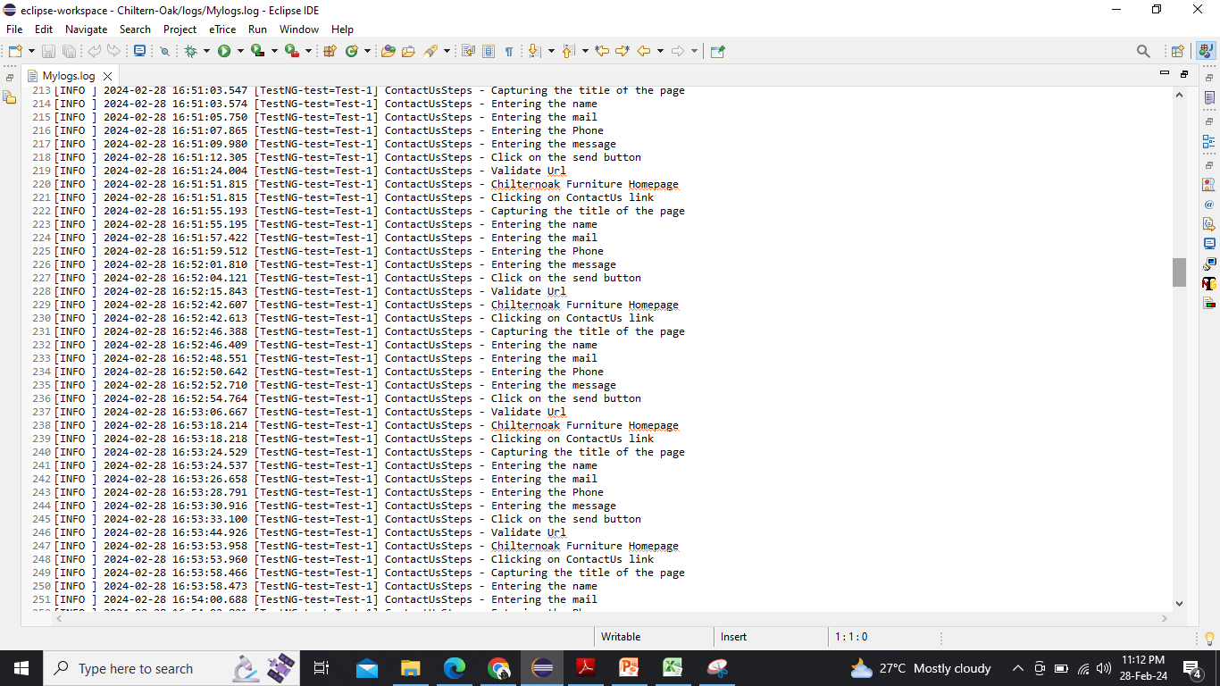
EXTENT REPORTS

Slide 47
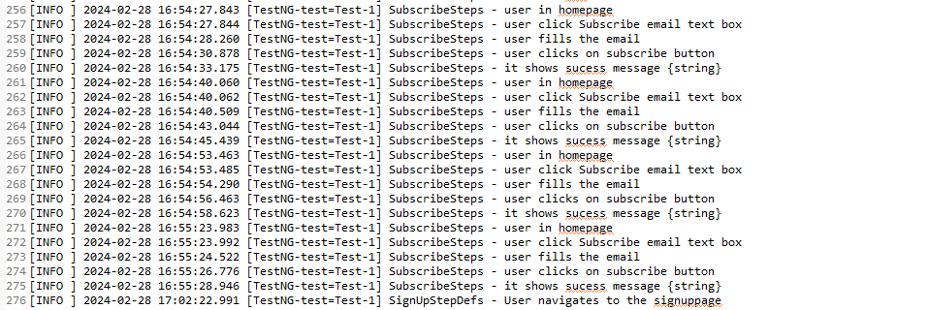
LOGS

Slide 48
Introduction to Page Object Model (POM)
POM is a design pattern used in test automation to create a clear separation between the structure of the web application and the tests, providing a more maintainable and scalable approach.
Page Objects: Components representing the pages of the application, encapsulating the interactions and elements on each page.
Test Methods: Methods in the test code that interact with the Page Objects to perform actions and validations.
Advantages:
Code Reusability: POM promotes the reuse of Page Objects across multiple tests.
Enhanced Maintainability: Changes in the UI are isolated to the corresponding Page Object, reducing maintenance effort.

Slide 49
POM in Our Project
Page Objects in Use:
What We Do: We use Page Objects to represent each web page in our testing.
Example: For instance, we have a LoginPage Page Object for the login page.
Real Testing Scenario:
How We Test: We'll walk through a simple test scenario to show how Page Objects are used.
Interaction: This includes interacting with elements and validating results.
Adaptability to Changes:
Handling Changes: POM helps us easily adapt to changes in the UI.
Example: If a button's location changes, we only update the Page Object, minimizing impact.

Slide 50
Jenkins
Jenkins is an open-source automation server widely used in the field of software development.
It provides a platform for continuous integration and continuous delivery (CI/CD), streamlining the software development process.
The Integrated Project was imported to Jenkins as a Maven Project using Source Code Management (SCM) through Github repository URL and the build was executed.

Slide 51
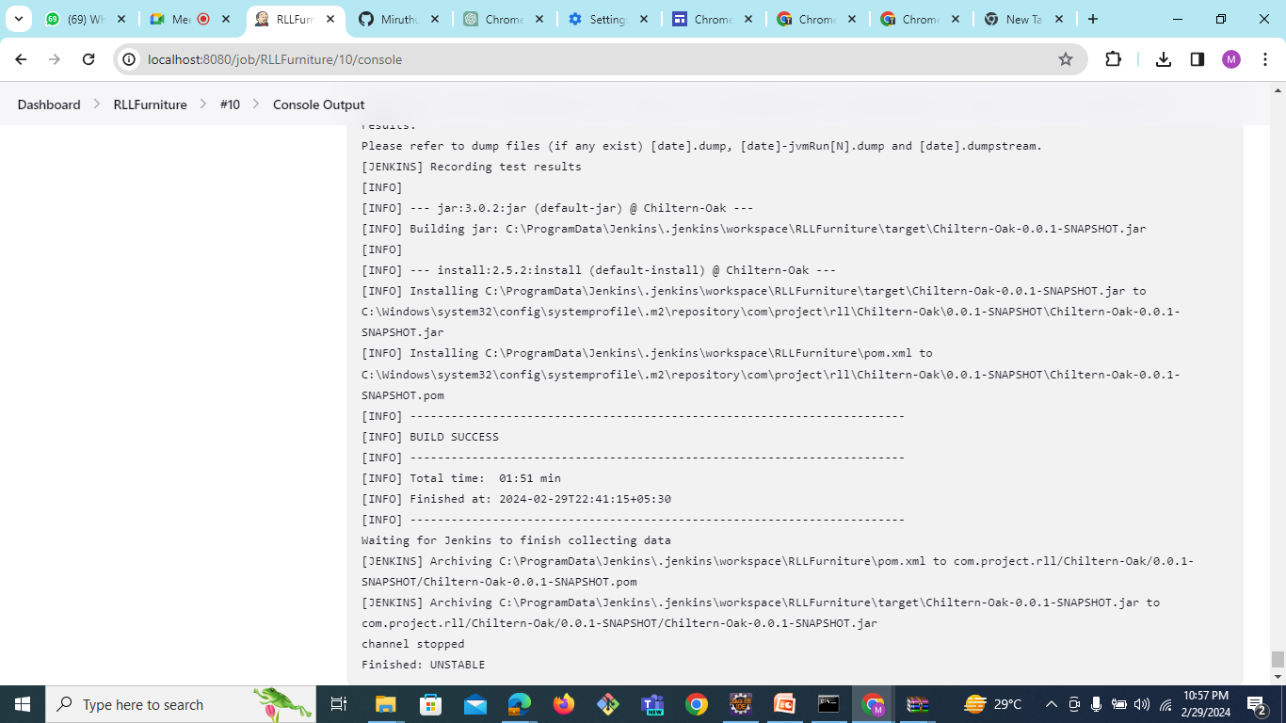

Slide 52
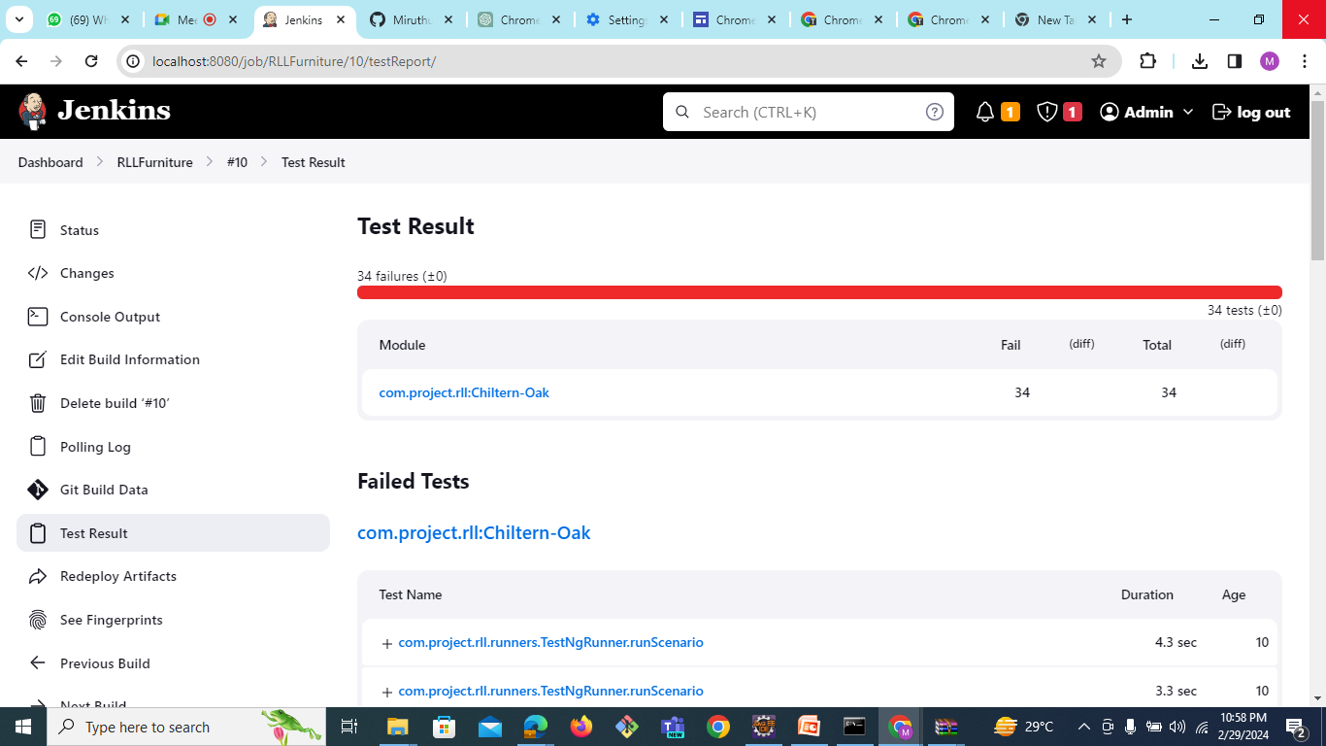

Slide 53
JIRA
What is jira:
Jira is a very powerful project management tool and some of the main part of jira is projects, issues and workflow.
We can defining goals and setting up team collaboration and add all your teammates in a single project.
Use of jira:
We use Jira's planning features for effective project management. We use dashboard for tracking and monitoring.
Integrate jira with zephyr scale, with the help of zephyr scale import our all the Manual test cases and assign everyone according to scenarios. And after assigning work on that zephyr scale.

Slide 54
Jira Features
We create daily sprint in jira, set daily goals and issues in our jira.
In board you can check daily activity of any users whom you assign tasks like they did it complete or its in progress now.
In list section you can have a list of all the activity where status of every activity show here.

Slide 55
Why Jira?
Jira provides a robust project management methodology specifically designed for software development.
It allows full customization of team management projects, catering to the unique needs of each team.
Jira equips users with tools for estimating, reporting, and measuring workflow and daily activities.
Teams can easily utilize Jira for managing regular development tasks, bug tracking, and product management.

Slide 56
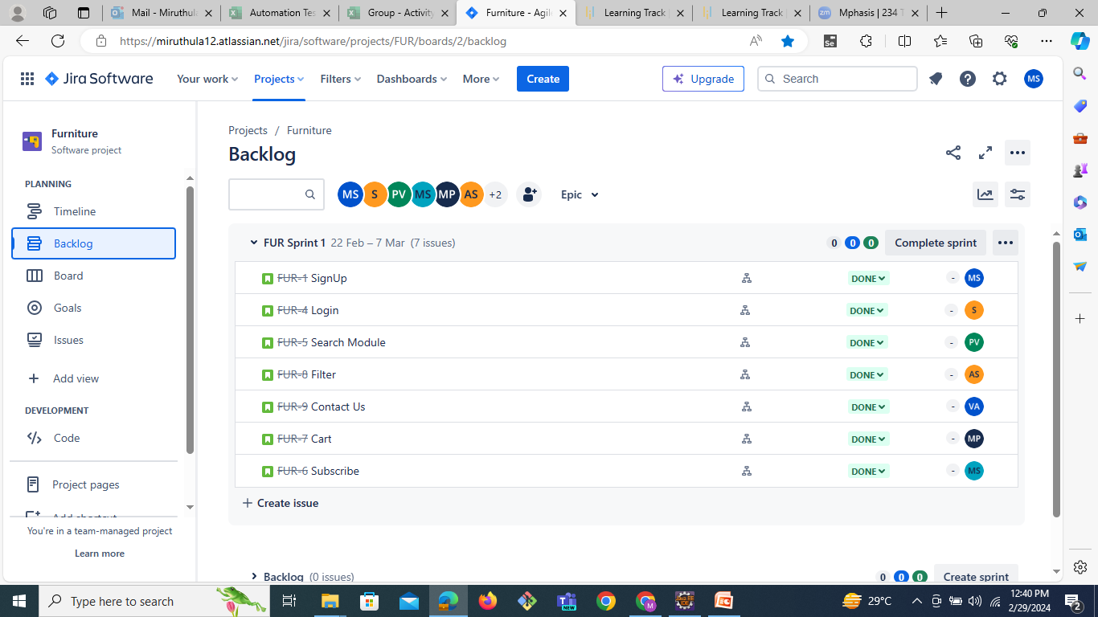

Slide 57
Conclusion
The project met the specified requirements and implemented successfully.
Test scenarios are verified including positive and negative test cases.
Successfully Generated the Extent Reports.
JIRA is utilized for Test Management Lifecycle
GIT URL: https://github.com/psvishal9/Chiltern-Oak-RLL.git
Have included the Merged Project in the Git Repository

Slide 58
THANK YOU

